Slide 1
Detailed Project Report
By :Abhishek Sachan
Last Revised Date:28/12/2022

Slide 2
Contents:
Problem Statement
Data Sets Information
Architecture Design
Different Graphical Analysis
Deployment

Slide 3
Problem Statement
With FIFA being in the blood as many people of the world. You are tasked to tell the story of unsung analysts who put great efforts to provide accurate data to answer every question of fans.
Football Game Analytics Detailed attributes for every player registered in the latest edition of FIFA 19 database.

Slide 4
Datasets Analysis
FIFA 19 Different Attributes likes:
Players Name
Ages
Nationality
Wages
Values
Contract valid
Positions
Overall Rating and Potential
Weights
Heights
Clubs
Leagues

Slide 5
Datasets Analysis
Players Features and Skills:
Stamina
Acceleration
Goal Keeper Reflexes, Goal Keeper Diving, Goal Keeper Position
Vision
Sprint Speed
Heading Accuracy
Marking, Standing Tackle, Sliding Tackle, Composure
Power, Balance, Ball Control, Long Shot, Short Passes, Finishing,Penalites.

Slide 6
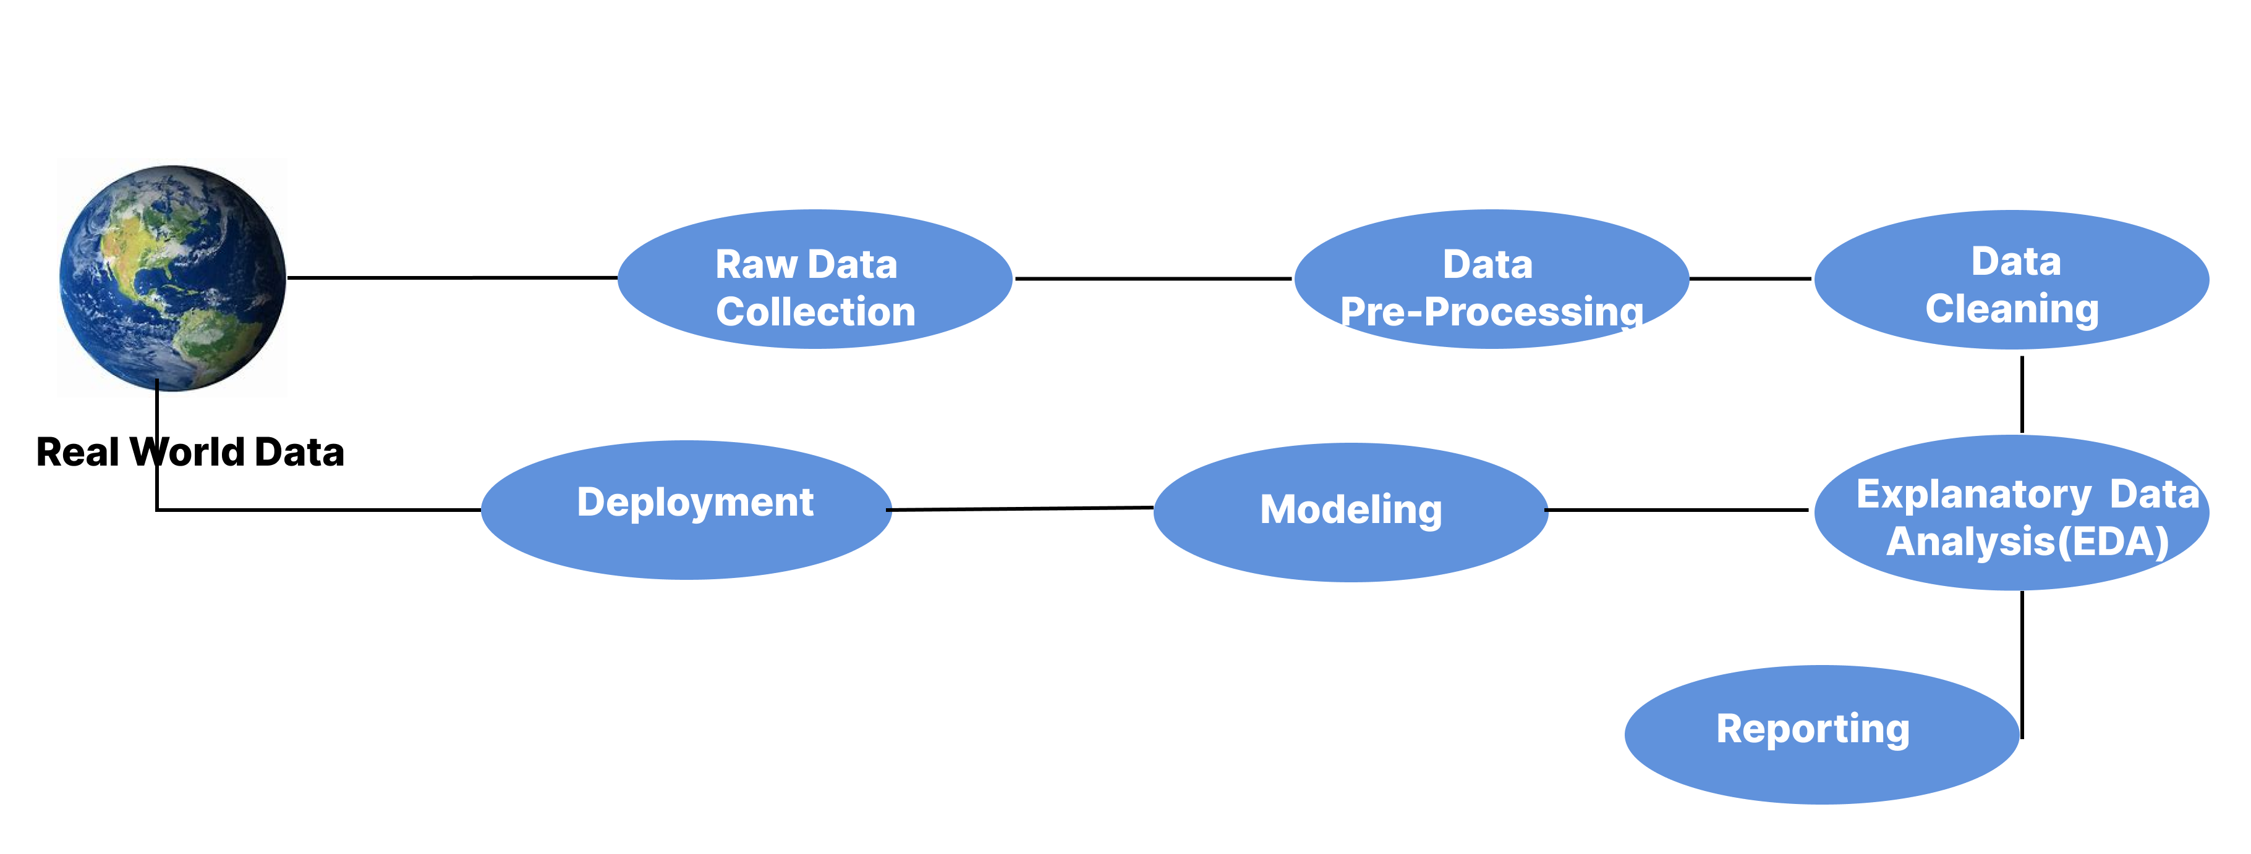
Architecture Design:

Slide 7
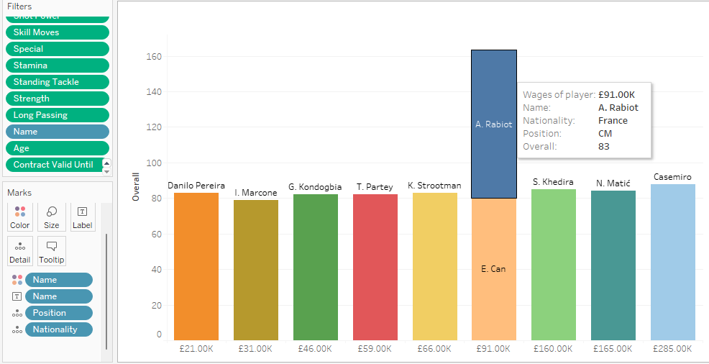
Different Graphical Analysis:
Top 10 Mid Fielder in my Teams
Factors Affects Results
Ages:23-31
Contract Valid:2019-2023
Short Passing:80-93
Shot Power:70-95
Stamina:75-96
Long Passing:75-90
Strength:80-92

Slide 8
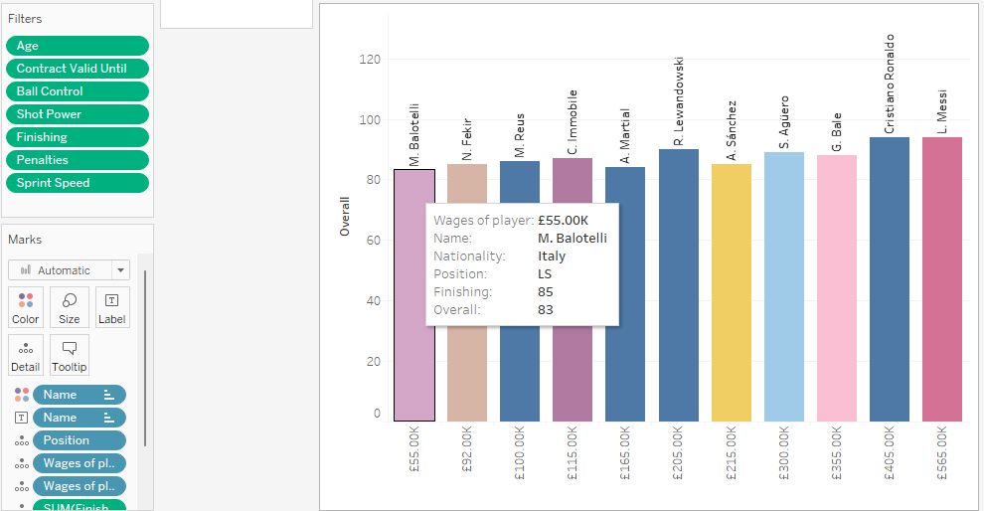
Different Graphical Analysis:
Top 10 Strikers in my Teams
Factors Affects Results
Ages:22-33
Contract Valid:2018-2023
Ball Control:83-96
Shot Power:84-95
Finishing:80-95
Penalites:75-92
Strength:78-95

Slide 9
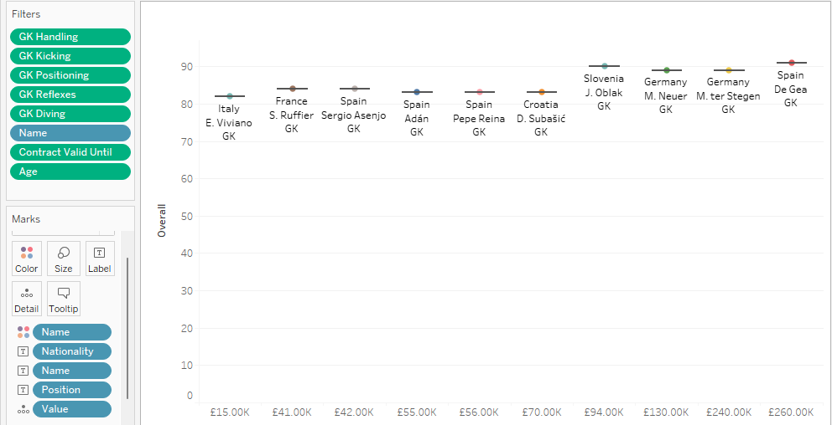
Different Graphical Analysis:
Top 10Goal Keepers in my Teams
Factors Affects Results
Ages:23-31
Contract Valid:2019-2023
Goal Keeper Kicking:79-91
Goal Keeper Reflexes:81-94
Goal Keeper Positioning:79-98
Goal Keeper Diving:79-88

Slide 10
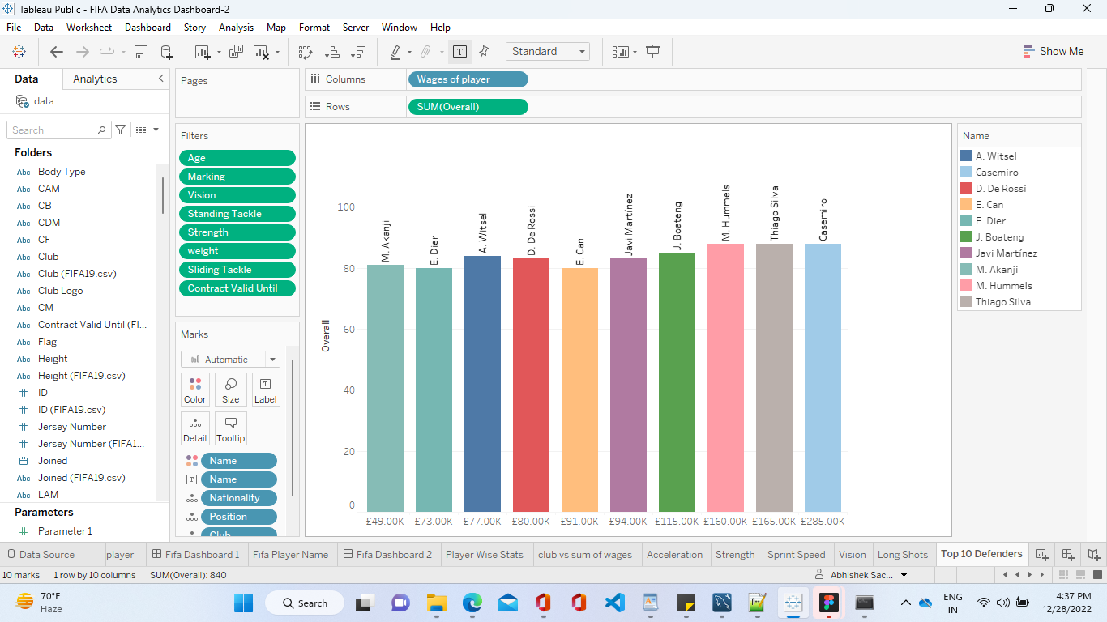
Different Graphical Analysis:
Top 10 Defender in my Teams
Factors Affects Results
Ages:22-35
Contract Valid:2019-2022
Marking:80-93
Standing Tackle:73-92
Sliding Tackle:80-91
Weight:75-90 Kg

Slide 11
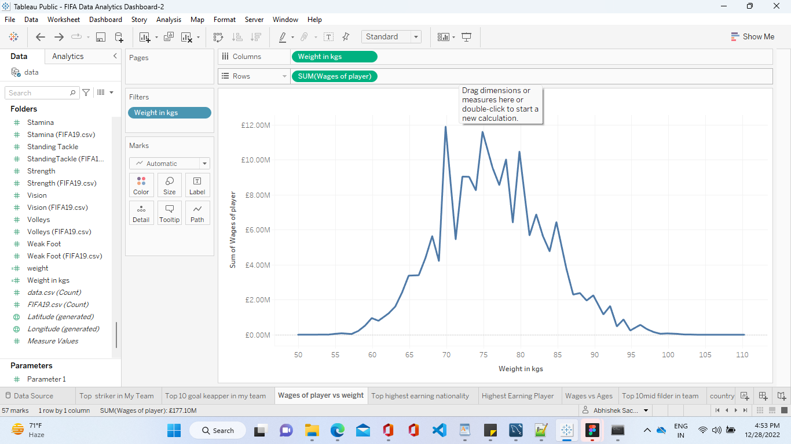
Different Graphical Analysis:

Slide 12
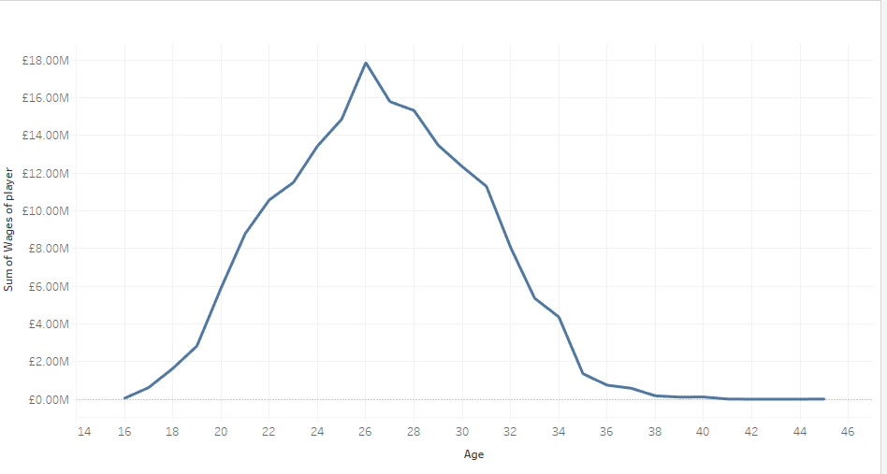
Different Graphical Analysis:

Slide 13
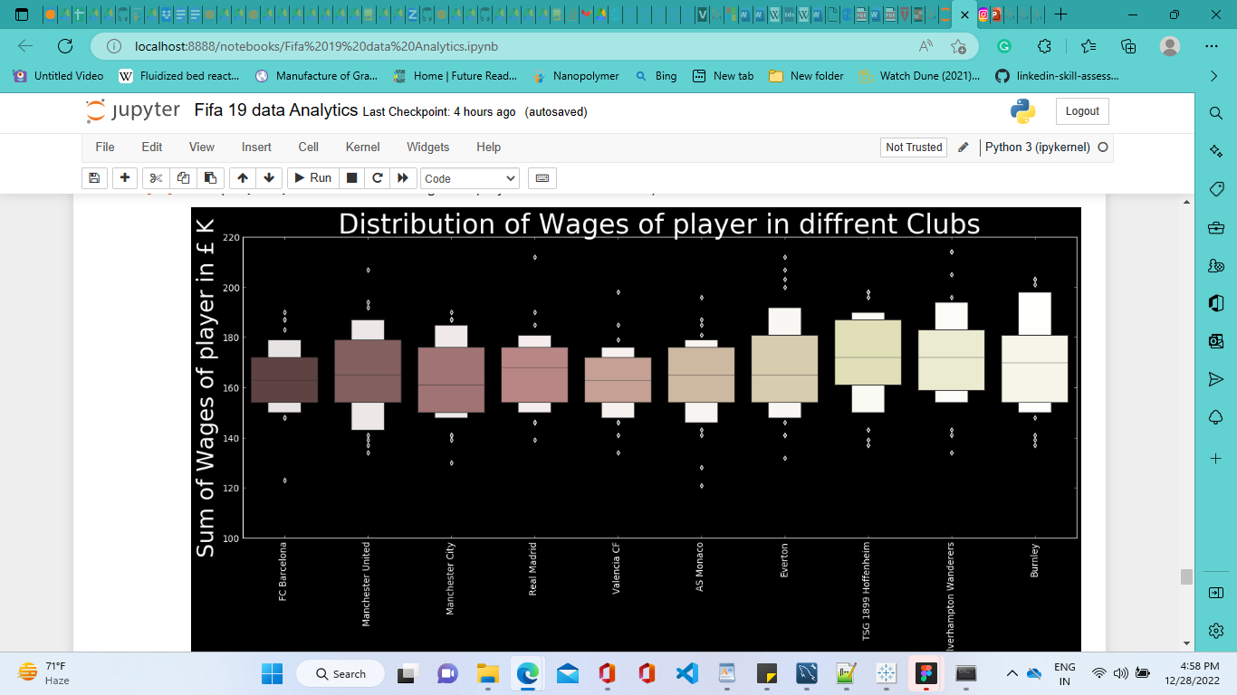
Different Graphical Analysis:

Slide 14
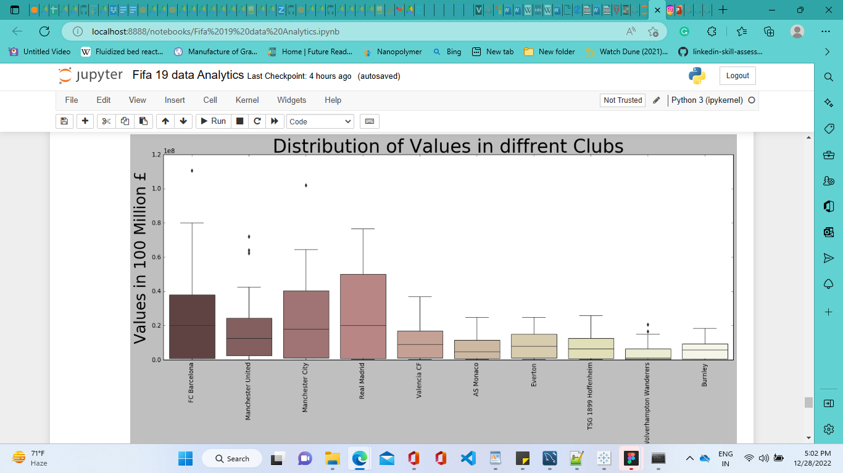
Different Graphical Analysis:

Slide 15
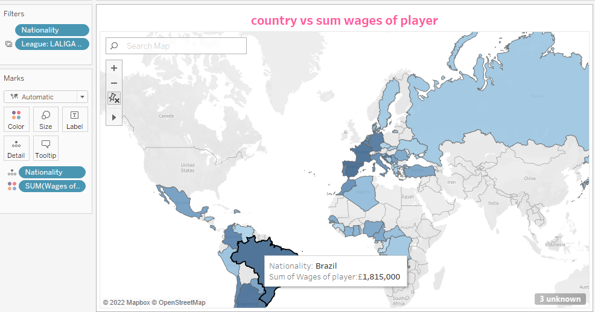
Different Graphical Analysis:

Slide 16
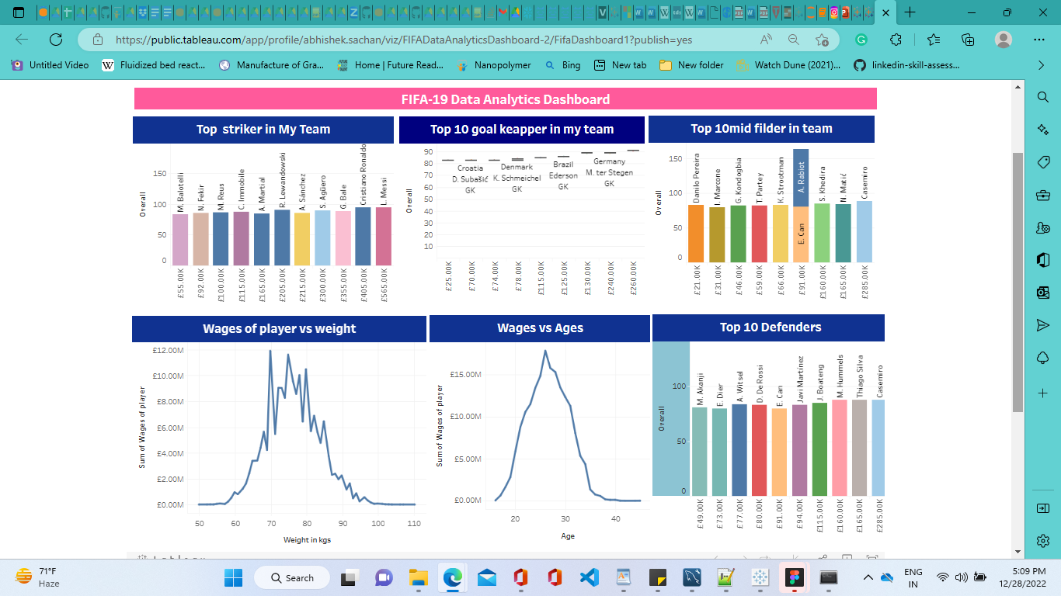
Deployment

Slide 17
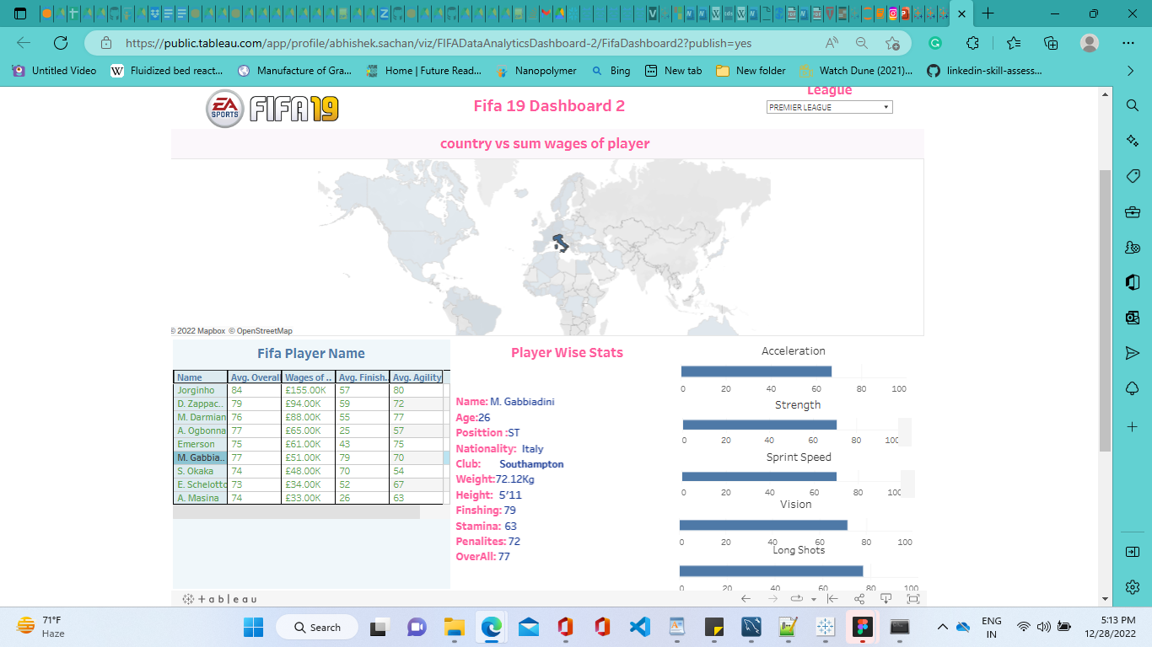
Deployment

Slide 18
Thank You

